Slide 1
Virtual Reality
Chris Constantine
(I figured you were tired of white or blue slides)

Slide 2
Overview
What is VR
Techniques of VR
History of VR
Uses of VR
Future Possibilities
Conclusions
Sources

Slide 3
What is VR
Virtual Reality is defined as:
  Simulated environment (computer?)
  Interaction with human senses
  Reactive to input from person
What can be VR
  Just about any simulated environment

Slide 4
Better example of what VR is…
(just follow along… trust him)

Slide 5
Techniques of VR
Types of VR
  Glasses
  Personal mobile suits
  Head mounted visors
  Tracking/Non-Tracking
  Motion Capturing
  Fully enclosed systems
‘Natural’ VR (yeah, you just did that)

Slide 6
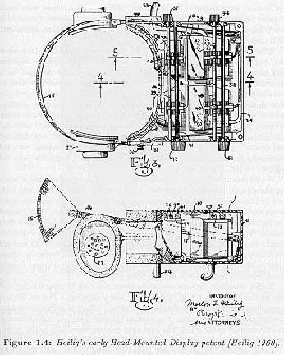
History of VR
Morton Heilig
  Not in computers!
  Surround sound idea for the eyes…
“…why use 18% of the viewer’s field of vision in 2D, when we can use 100% in 3D…”

Slide 7
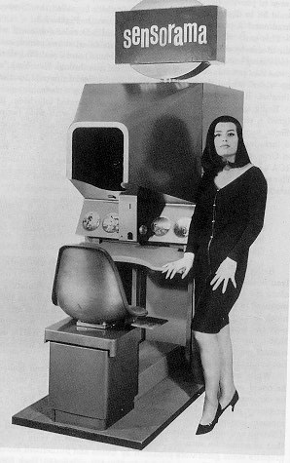
$ $ $
Oops… No money!
  Heilig’s plans fell through…
  Sensorama! (early 60’s)

Slide 8
Ivan Sutherland
Heilig’s ideas fell through, Ivan Sutherland, a student at U. Utah continued.
1966… Created his version… happy!
  NASA and military realized the potential.
  (more on that later)

Slide 9
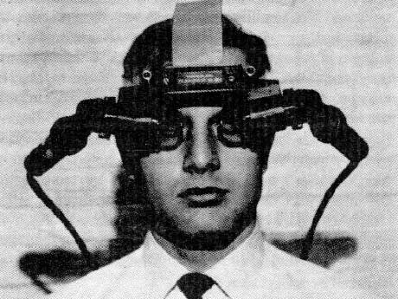
Hey, Look at me!
Man, Don’t I look cool!

Slide 10
Sutherland’s Revolutions
Heilig’s machine = cameras
But…
Sutherland’s idea = CRT’s, graphics accelerators, computer generated images.

Slide 11
Further advances
Faster image generation systems
  Realtime wireframe drawing
Real world input/output…
  Enables interactivity
  3D position sensors…

Slide 12
VR as we know it
Now, we have VR in the same form as today.
Computer systems with reactive capabilities generate simulations of any environment.

Slide 13
Uses of VR
Late 1960’s (the main players in history)
  Military
  NASA
  Took Sutherland’s ideas and advanced them to use in flight simulations.
    That cool headgear returns!

Slide 14
Neat things VR is used for today
Phobias
  - Fear of Heights, Flying, Spiders, Public Speaking, Driving…etc
Physical Therapy
Education

Slide 15
Training
  Military
    Microsoft flight sim?
  Scholarly
  Medical
  Construction
  Law Enforcement
  Lots more….

Slide 16
Future of VR?
Future only bound by technological advance
  Nanotechnology?
  Implants?
U. Washington already researching:
  Retina image screening
  Nervous system implanting (EEG and EMG)
Unmanned Flight
  Gulf War…

Slide 17
Conclusion and Summary
VR came about as an idea from a cinematographer named Morton Heilig in 1960
Ivan Sutherland continued when Heilig ran out of money (doh)
Military liked Sutherland’s idea and helped him develop it. (around 1966)
NASA really liked it, poured in tons of money. (late 60’s / early 70’s)

Slide 18
What is VR?
  Just about any simulated environment a user can actively experience
Terminator-esque future?

Slide 19
Sources
VIRTUAL REALITY - http://ei.cs.vt.edu/~history/Tate.VR.html
Evolution of Virtual Reality - http://www-ec.njit.edu/~gdb1498/Portfolio/CIS350TermPaper2.html
History of VR - http://www.cs.jhu.edu/~cohen/VW2000/Lectures/History.color.pdf
Virtual Reality – History - http://archive.ncsa.uiuc.edu/Cyberia/VETopLevels/VR.History.html

Slide 20
Virtual Reality Techniques in Education and Training: Technological Issues - http://www.agocg.ac.uk/reports/virtual/vrtech/title.htm
SimVis Augmented Virtual Reality Techniques - http://www2.dcs.hull.ac.uk/simmod/Topics/virtual_environments.htm
Use of Virtual Reality techniques - http://www.dinf.ne.jp/doc/english/Us_Eu/conf/csun_98/csun98_001.htm
VR techniques and illusions - http://www.cs.ucl.ac.uk/staff/A.Steed/vr-intro/
Virtual Reality Rentals, Explaining VR - http://www.rentvr.com/truevr.html

